Slide 1
Breast short case
Dr M D P Pinto
Department of Surgery
FOM / UOK

Slide 2
Common cases
Young girl with a fibroadenoma
Middle age/ premenopausal lady with breast CA
Patient following surgery and adjuvant therapy
Rare – firm lump, tender or not, following breast injury (traumatic, surgery = fat necrosis

Slide 3
Prerequisites
Consent
Privacy
Lighting - adequate
Exposure – umbilicus upwards
Position - best 45 degrees; if not – seated
Pain ?

Slide 4
Inspection
Take an overall view first
Patient
General appearance – emaciated / average built
Hair – alopecia
Diseases - jaundice/ pale
SOB
Breast
Asymmetry
Skin changes – erythema , peau d’orange, nodules, ulcers/ elevate arm to show puckering
Scars
Nipple/ areolar – retraction/ destruction/ asymmetry, discharge

Slide 5
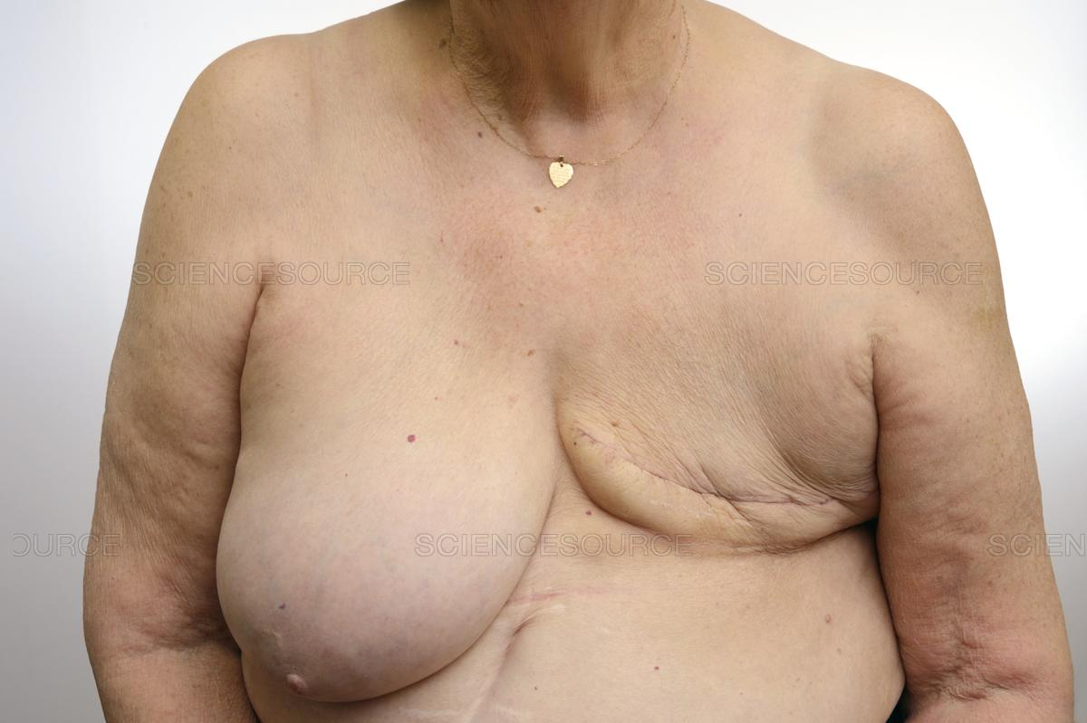
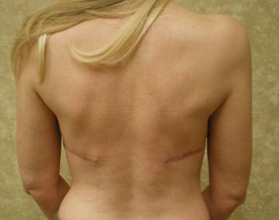
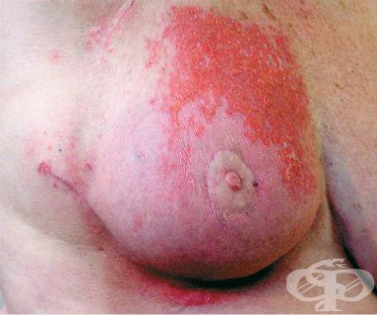
Inspection
Axilla
Lumps
Scars
Signs of previous treatment
Scars of mastectomy
Scars of breast reconstruction
Radiation dermatitis – erythema/ telangiectasia
Signs of complications
Ipsilateral lymphedema
Seroma

Slide 6
Palpation - breast
Keep arm abducted with hand behind the head
Pain?
4 quadrant or circular movements
Lump examination
Site
Size
Shape
Surface
Edges
Consistency
Mobility/ fixity
Skin – try pinch skin out – can’t? – tethered
Raise arm – skin over lump goes down – dimples = puckering
Chest wall - check mobility along pec major fibers first → hands on hips and press in to contract pec major and check again = reduced?
Skin
Warmth
Ulcer – describe number / edge/ base
Examine the axillary tail
Examine the contralateral breast

Slide 7
Palpation – LN
AXILLA
Seated
Keep upper limb rested on yours
Check with gentle, other hand
Walls of axillae
Anterior, posterior, lateral, medial and apical
LN?
Matted/ discrete
Mobile or fixed?
Check ipsilateral supraclavicular node

Slide 8
Completion
I would like to check for;
Nipple discharge
Abdominal examination – hepatomegaly, craggy liver border with mets
Auscultate lungs – lung signs with mets
Cover back clothes – when you finish examination

Slide 9
Present
According to the case
T and N status

Slide 10
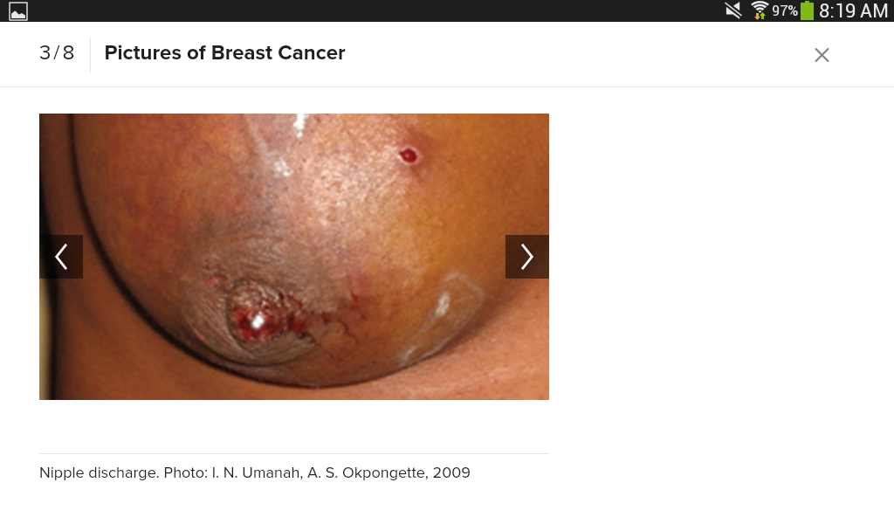
Nipple discharge
Bloody discharge
CA – single duct
Benign
Duct papilloma - single duct
Occasionally with duct ectasia
Multiple ducts
Cytology is usually not helpful unless CA

Slide 11
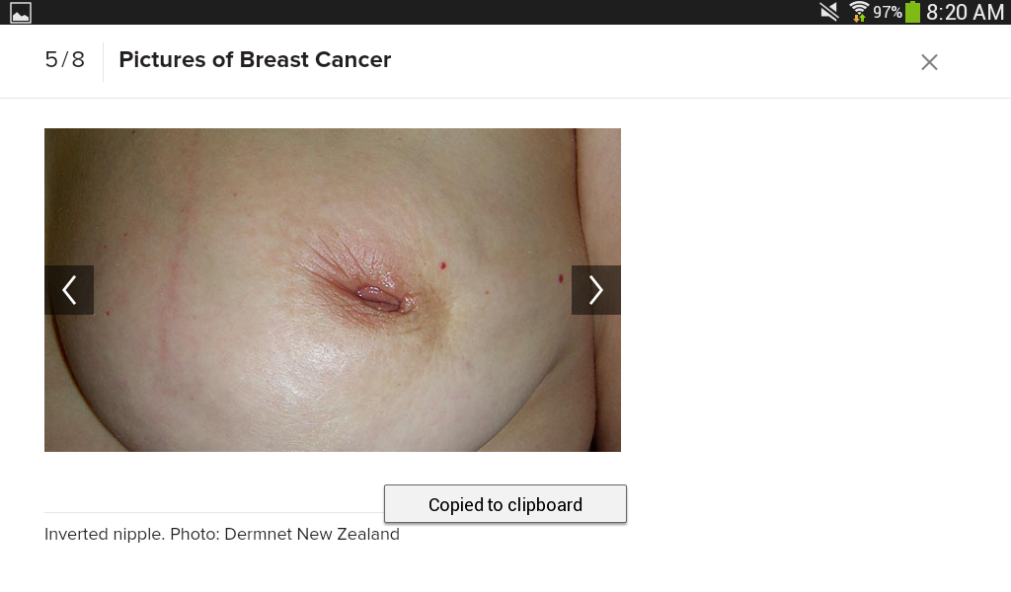
Nipple inversion
Underlying malignancy retracting the nipple
Is it recent onset? Or congenital

Slide 12
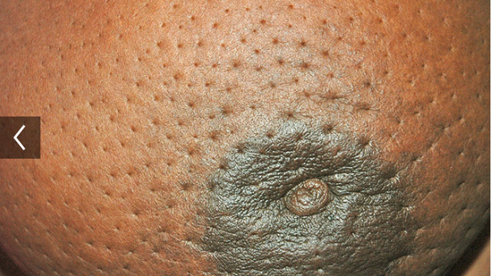
Peau d’orange
Lymphatics within the breast communicate with a sub areolar lymphatic plexus
Orange peel appearance occurs with blockade of cutaneous lymphatics by tumour cells → causing cutaneous oedema
There is counter pressure by taut ligaments of cooper so skin is taut over the lump
This is 4b disease

Slide 13
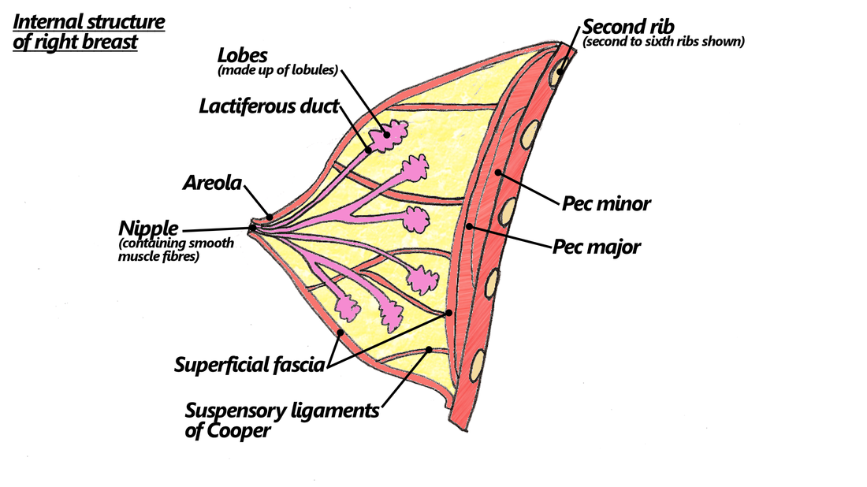
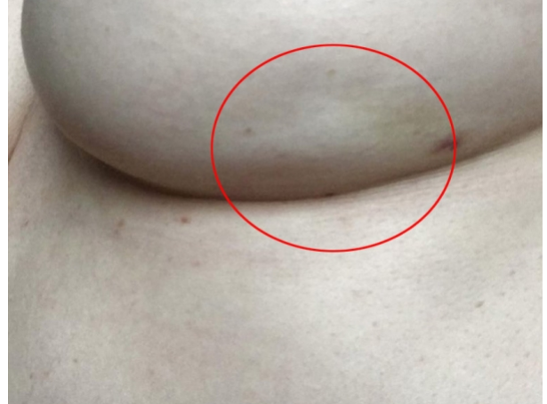
Puckering of skin
Breast has a thickened posterior capsule – thickened fascia of Scarpa
From it fibrous bands go to breast dermis – shape!
CA gets these entangled – puckering or dimpling

Slide 14
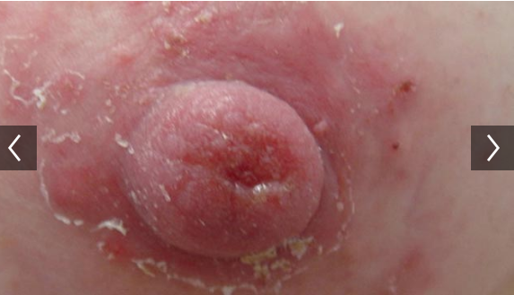
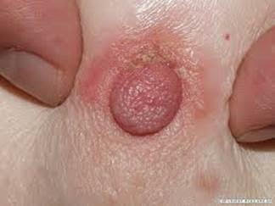
Nipple eczema (Benign)
Ask – atopic eczema?
Confusion – Paget's disease of nipple (malignant – 4% of all breast CA)
In nipple eczema
Areolar more affected
No lesion in mammography
Scrape cytology is benign
Differ – only with incisional biopsy
PAGET’S NIPPLE

Slide 15
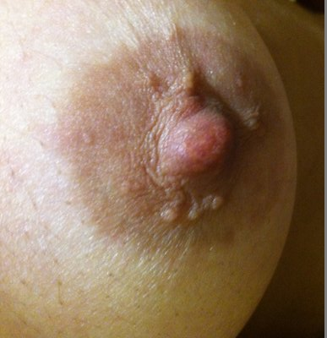
Enlarged Montgomery glands
Benign
Sebaceous glands
May enlarge
Pregnancy
Puberty
Menstrual cycle
Can get infected

Slide 16
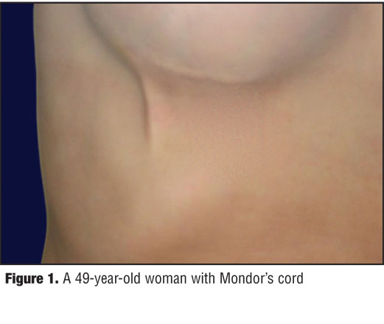
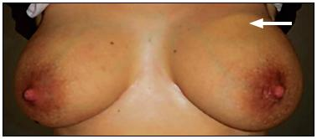
Mondor’s disease/ cord
Superficial thrombophlebitis of veins on breast
Self limiting – benign – painful
Occurs in penis / axilla (axillary web syndrome)
Treatment - analgesia

Slide 17
Thank you

